Slide 1

UNDERSTANDING DATA TYPES

Slide 2





Independent vs dependent features/variables
Features:
There are always two types of features/variables/columns:
Independent / predictive ( those that we will use to make predictions )
Dependent / Target ( WHAT want we want to predict USING the INDEPENDENT FEATURES )

Slide 3


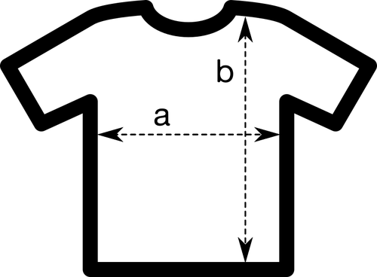
Types of features
Features:
There are always two types of features or variables:
Numerical: (numbers: 1, 2, 3…,3.15, 38.4)
Categorical (tags)
Ordinal ( they display some kind of order )
Nominal (they don’t have any order
Dates:
Usually we use date differences.
How we can distinguish between them?
Numericals express an amount (they can be added, subtracted, multiplied, divided..)
Categoricals doesn’t express an amount, express a tag.

Slide 4
Value Types found on datasets
Value types:
We can find different type of features in a dataset:
Numerical:
Integers
Float numbers
Categorical (tags )
Characters (“a”, “b”, “W”,....)
Strings (“My car is red”, “Yahoo!”, “englishhh”,...)
Booleans ( True / False, Yes / Not)
0

Slide 5
Types of Machine Learning tasks
The type of machine learning task is determined by the type of the dependent feature.
Numerical -> Regression task ( predicting amounts )
Categorical -> Classification ( predicting categories/labels )
The type of task determines the what error metrics you will use to evaluate your model.

Slide 6


Garbage in / Garbage out
Value types:
A model prediction will never be better than your input data!

